Slide 1
An overview of salary distributions across various dimensions in the data science field.
Presented by:
Sri Kalyan Reddy, Akiti
Sandeep Kumar, Adi
Sanjay Kumar, Pujari Pushparaj
Under the guidance of Prof. Zheng, Wei

Slide 2
01
Introduction
CONTENTS
02
Data Description
03
Data Cleaning & Pre-Processing
04
Exploratory Data Analysis
05
Statistical Analysis
06
Findings
07
Conclusion

Slide 3
01
Introduction
Overview:
Our project delves into a comprehensive analysis of salary trends and disparities within the field of data science across California. Utilizing detailed datasets from multiple sources, the study examines how different factors such as job title, company prestige, geographical location, and educational qualifications impact the compensation of data science professionals.
Objective:
To identify the key determinants of salary variations and provide insights that can help professionals and employers in strategic decision-making.

Slide 4
Cont.,
Methodology:
The analysis involves cleaning and pre-processing the data, followed by exploratory data analysis (EDA) to uncover underlying patterns and trends. Further, statistical methods, including regression analysis, are applied to quantify the impact of different variables on salaries.
Significance:
This analysis not only highlights the current salary trends but also serves as a guide for upcoming professionals to understand what factors might influence their earnings in the data science field. For organizations, it provides a benchmark to strategize their salary offerings competitively.
“By the end of this presentation, you will have a clearer picture of the data science salary landscape, enabling both job seekers and employers to make informed decisions in this dynamically evolving field.”.

Slide 5
02
Data Description
1. Title, Location, and Company Salary Data (title_location_company_salary.csv):
Columns: Title, Location, Company, Salary
Description: This dataset comprises salary information segmented by job titles (e.g., Data Scientist, Data Analyst), company names, and their geographical locations. It provides insights into how salaries differ across companies and regions for similar roles.
2. Qualifications Data (qualifications.csv):
Columns: Title, Qualifications, Years of Experience
Description: Contains data on the educational qualifications and years of professional experience associated with various data science roles. This dataset helps analyse the impact of educational background and experience on salary levels.

Slide 6
Cont.,
3. Benefits Data (benefits.csv):
Columns: Title, Health Insurance, Retirement Benefits, Stock Options
Description: Details the additional benefits provided to employees beyond the base salary. It includes information on health insurance, retirement plans, and stock option availability, offering a comprehensive view of the total compensation package.
Purpose of the Data:
These datasets enable a multi-dimensional analysis of the data science job market, focusing on the direct and indirect factors influencing salary structures. By integrating these datasets, we aim to provide a holistic view of what influences data science salaries and how these elements vary by demographic and professional criteria.

Slide 7
03
Data Cleaning & Pre-processing
Removal of Unnecessary Columns:
Action: Columns such as 'Unnamed: 0', typically generated during data export/import as additional indexing, were removed from all datasets to clean up the data format.
Handling Missing Values:
Action: We assessed the datasets for any missing values. Where necessary, decisions were made either to impute missing values using statistical methods (like median or mean) or to remove the rows entirely, depending on the extent and nature of the missing data.
Data Type Conversions:
Action: Ensuring correct data types is crucial for analysis. For instance, numeric fields stored as strings were converted to integers or floats, and categorical data types were assigned to features like Title and Location for proper categorization and analysis.

Slide 8
Cont.,
4. Normalization of Text Data:
Action: Text data such as job titles and location names were normalized by converting to a standard case format, removing any inconsistencies in capitalization or extra spaces, which helps in grouping data accurately during analysis.
5. Verification of Data Integrity:
Action: We conducted checks to ensure there were no duplicate entries or anomalies that could skew the analysis. This included verifying the uniqueness of certain records and reconciling any discrepancies in data entries.
Pre-processing Outcome:
These steps resulted in datasets that are streamlined and standardized, ready for detailed exploratory analysis and statistical modelling. The pre-processing phase ensures that our findings and insights are based on reliable and robust data.

Slide 9
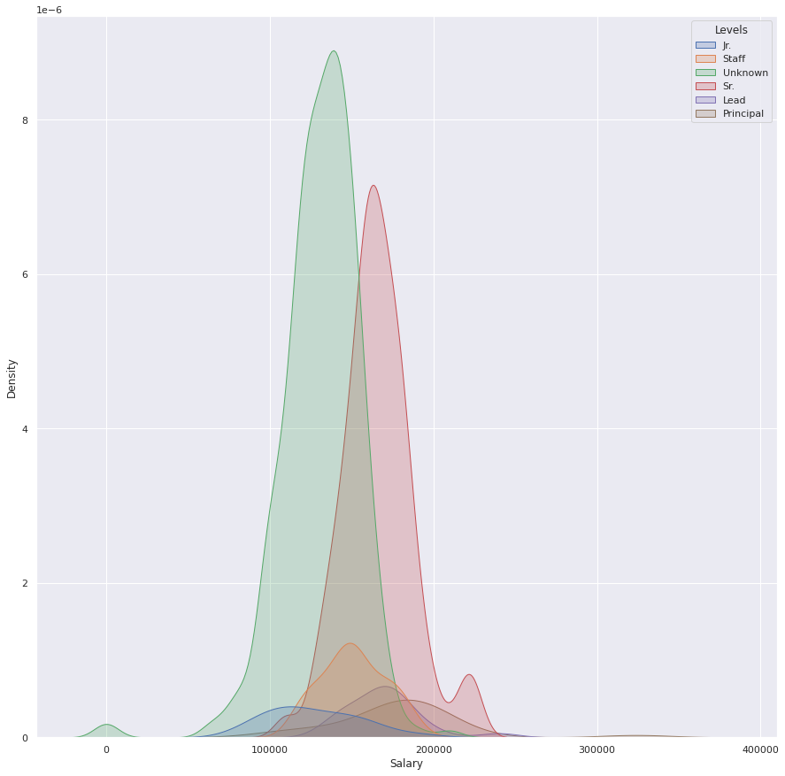
04
Exploratory Data Analysis
Distribution of Salaries by Title and Level:
Method: We used Kernel Density Estimation (KDE) plot to visualize the distribution of salaries for different job titles such as Data Scientists, Data Analysts, etc., at various levels (Junior, Mid, Senior).
Findings: The KDE plots revealed distinct salary distributions for each title and level, highlighting the variations and potential salary progression as one advances in their career.

Slide 10
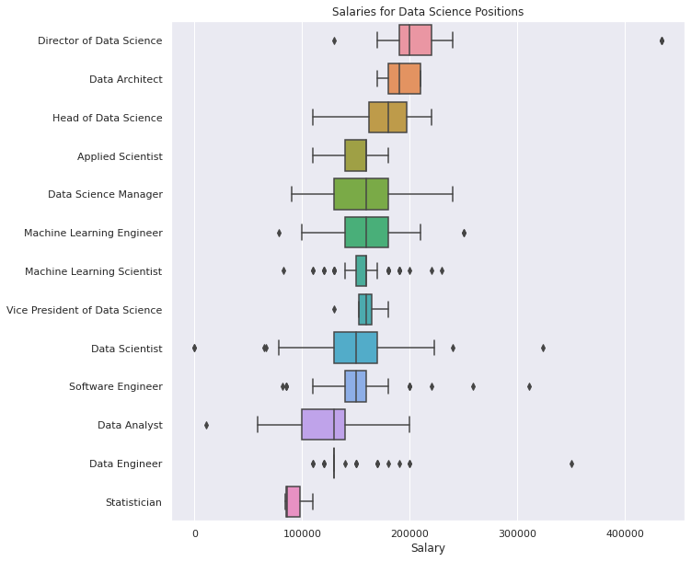
Cont.,
2. Box Plots of Salary Variations Across Job Titles:
Method: Box plots were generated to examine the spread and outliers of salaries within each job title category.
Findings: The box plots illustrated a wide range of salary distributions among different titles, with some roles showing greater variability and outliers than others. This indicates differential market valuations of skills and experiences associated with each title.

Slide 11
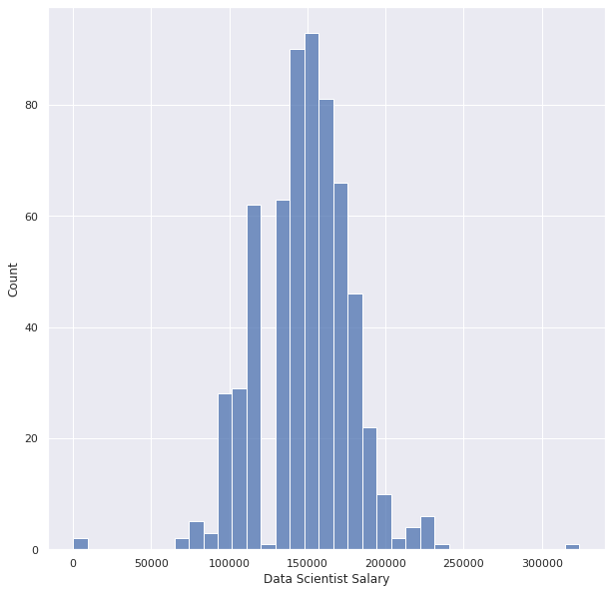
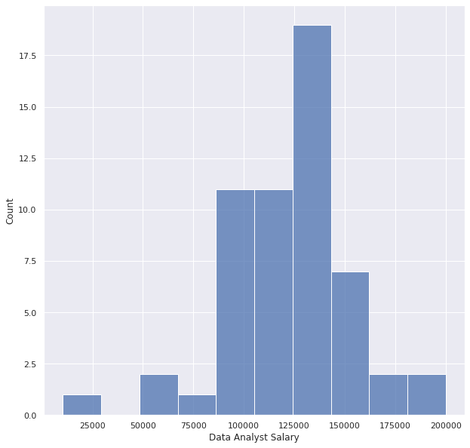
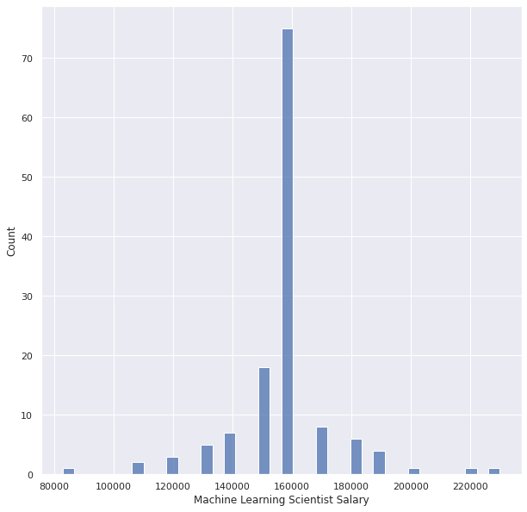
Cont.,
3. Histograms of Salary Distributions:
Method: Histograms were used to further analyse the frequency distribution of salaries for each job title.
Findings: These histograms helped identify the most common salary ranges and the skewness of salary distributions, providing insights into the typical earning potential within each role.

Slide 12
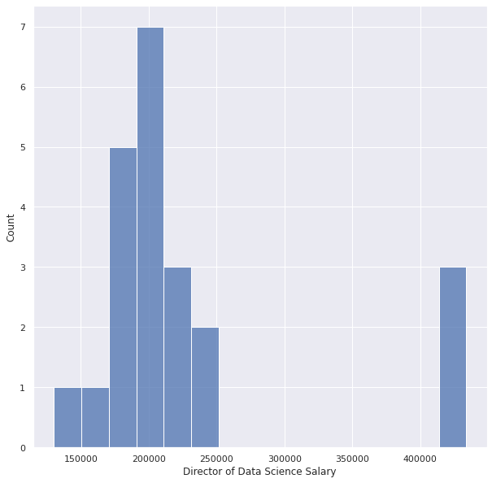
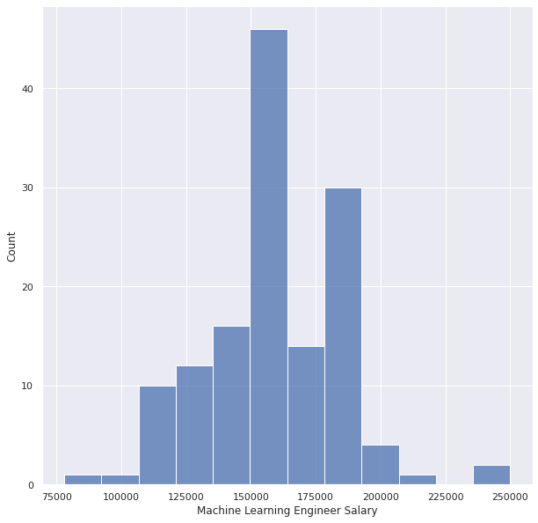
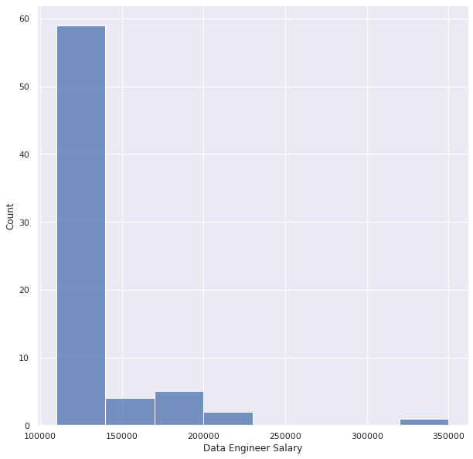
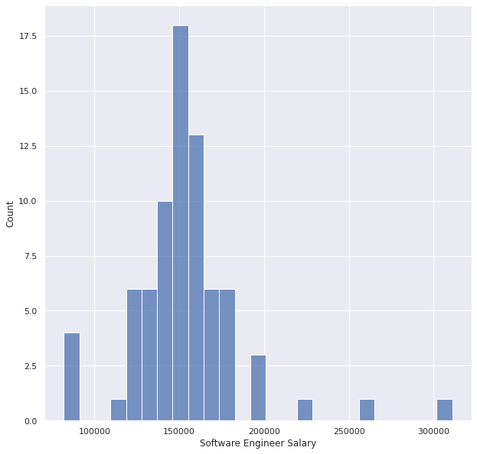
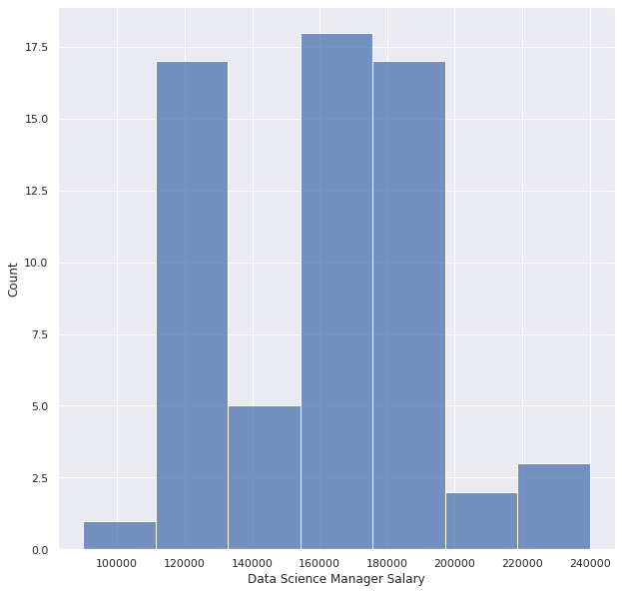
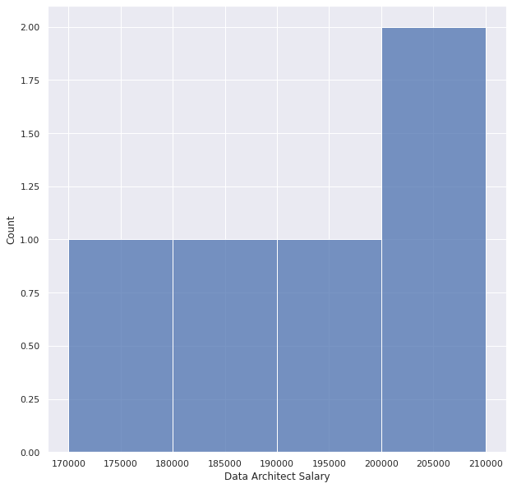
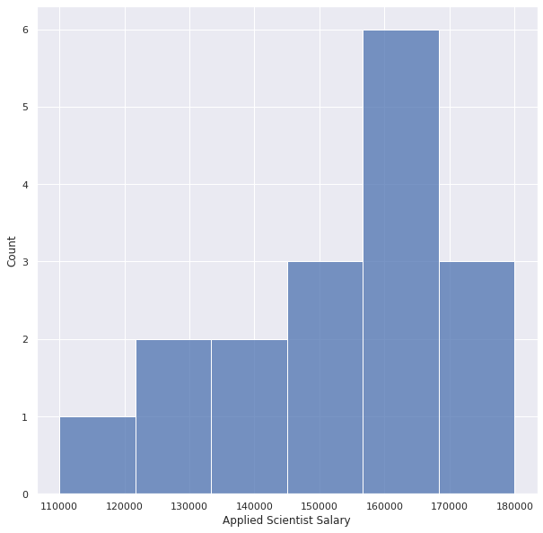
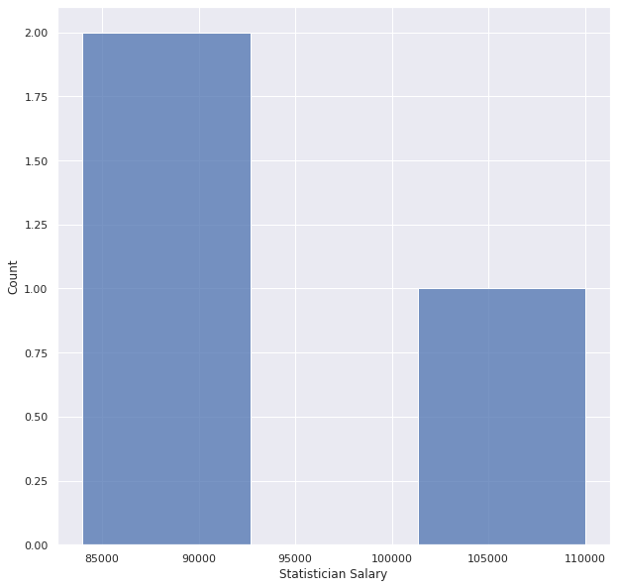
Cont.,

Slide 13
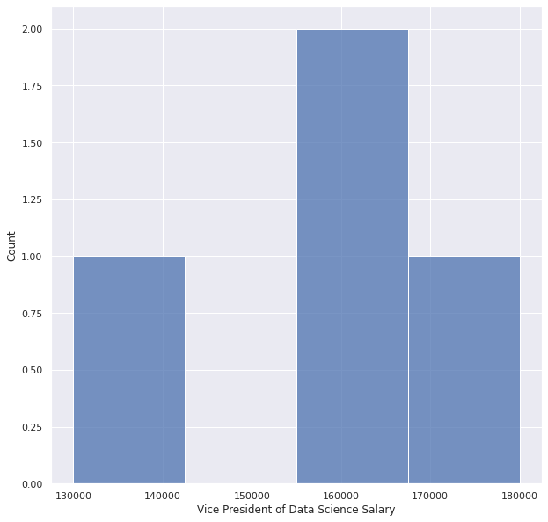
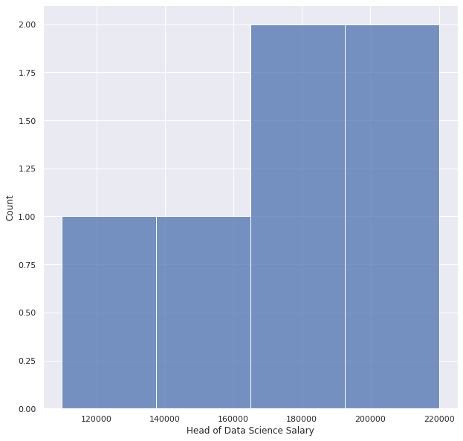
Cont.,

Slide 14
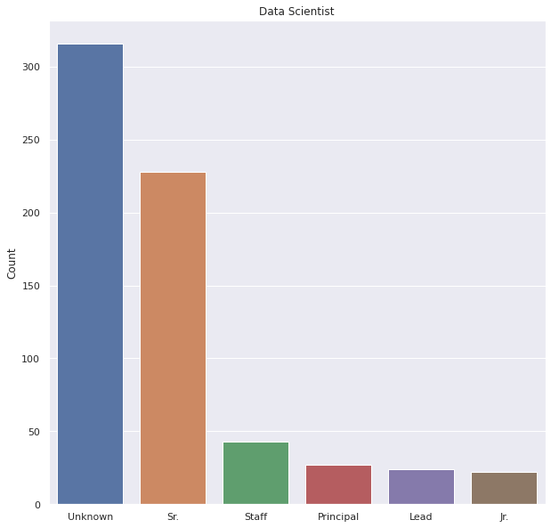
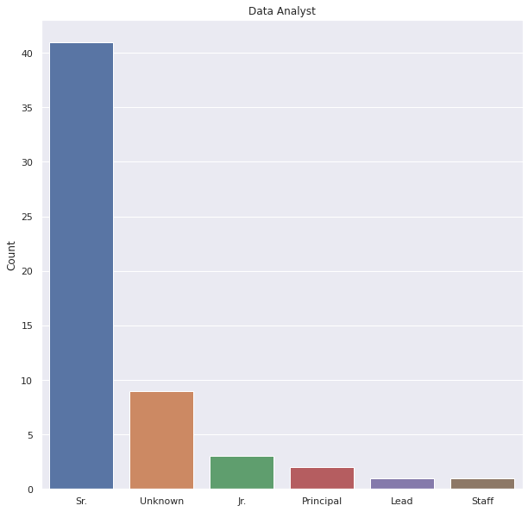
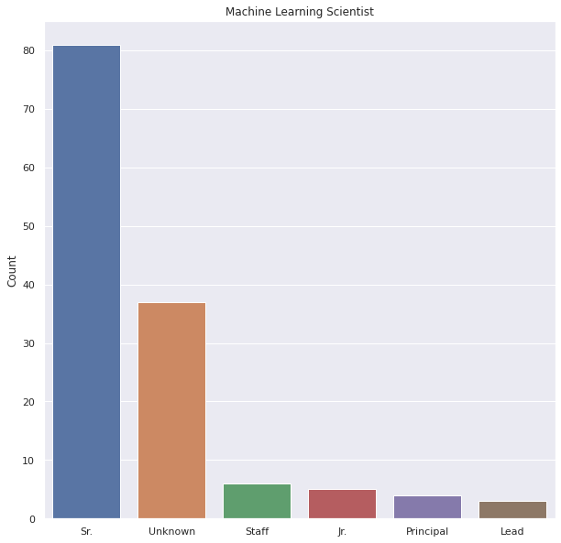
Cont.,
4. Comparative Bar Charts of Levels within Titles:
Method: Bar charts compared the count of individuals at different levels within each job title.
Findings: This visualization highlighted the relative frequencies of entry-level versus senior positions, suggesting potential career progression paths and bottlenecks in the industry.

Slide 15
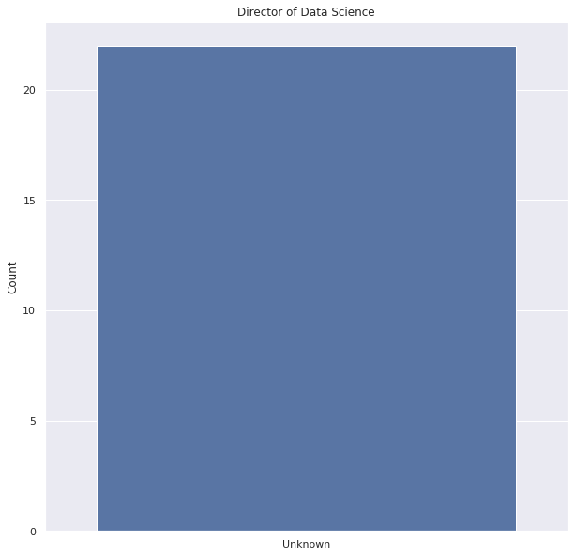
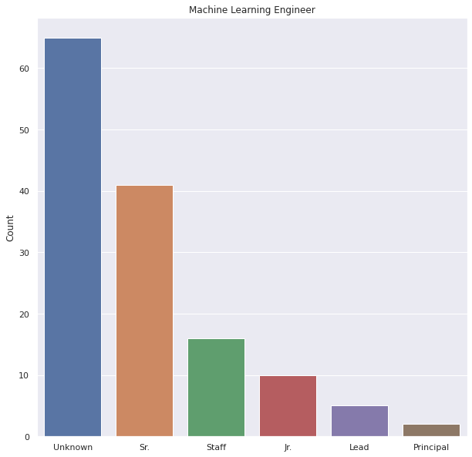
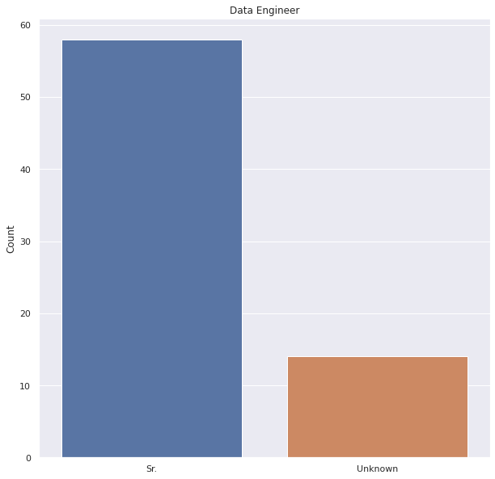
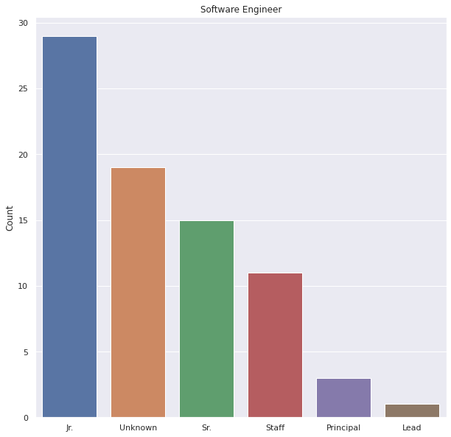
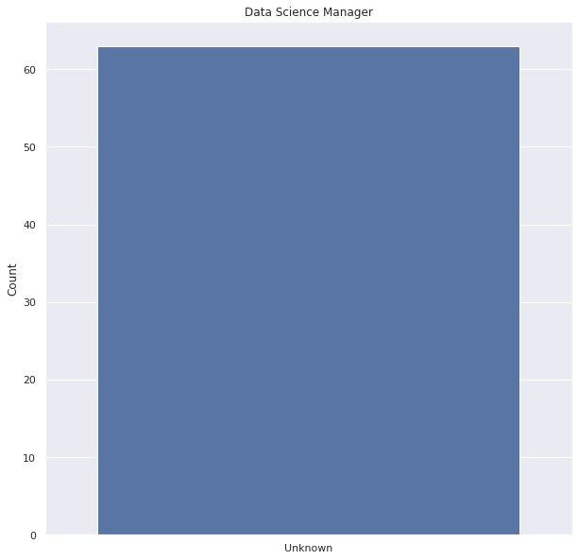
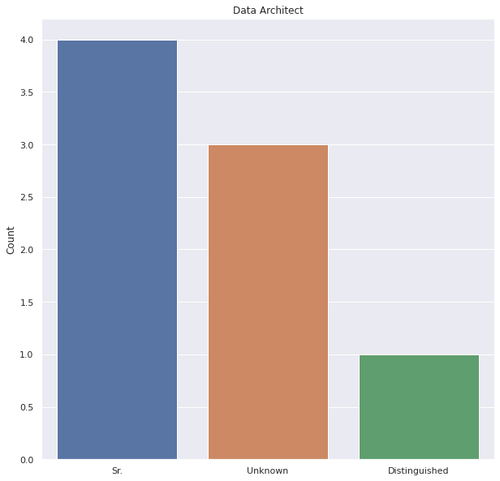
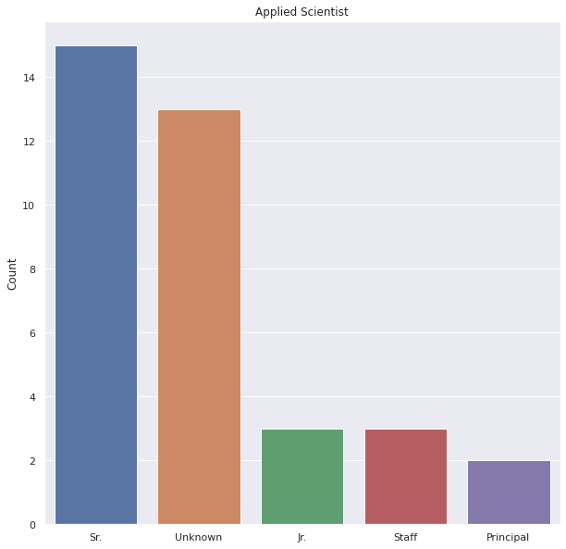
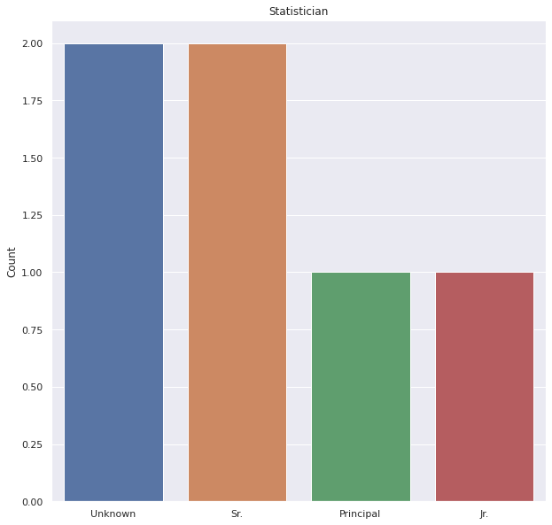
Cont.,

Slide 16


Cont.,

Slide 17
05
Statistical Analysis
Regression Model Details:
Model Used:
Type: Ordinary Least Squares (OLS) Regression
Purpose: To explore the relationship between salary and predictors such as job title, company, location, education level, and experience.
Equation: Salary = β₀ + β₁(Job Title) + β₂(Company) + β₃(Location) + β₄(Level) + β₅(Qualifications) + ε

Slide 18
Cont.,
2. Significant Predictors of Salary:
Variables Considered:
The model considered categorical variables for job title, company, and location, as well
as ordinal variables for levels and quantitative measures for qualifications.
Findings:
Job Title: Significant impact on salary, with certain titles like 'Senior Data Scientist’ commanding higher wages.
Company: Certain companies are associated with higher salaries, possibly reflecting industry reputation and revenue scales.
Location: Geographic location played a crucial role, with places like San Francisco and New York offering higher salaries due to cost of living and demand for skills.
Level: Higher levels within job titles showed a positive correlation with salary, indicating that career advancement is a reliable predictor of increased earnings.
Qualifications: Advanced degrees and relevant certifications showed a positive effect on salary, although the impact varied across different job titles.

Slide 19
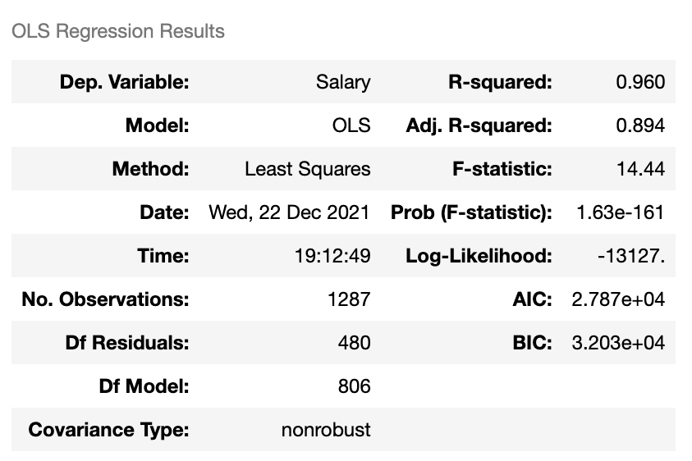
Cont.,
Model Performance and Evaluation:
R² Value: Indicated how well the variables explained the variance in salary: 0.960
F-Statistic: Demonstrated the overall significance of the regression model: 14.44
Implications:
These findings provide actionable insights for both employers and employees. Employers can better structure their compensation strategies, while employees can focus on areas that enhance their earning potential.

Slide 20
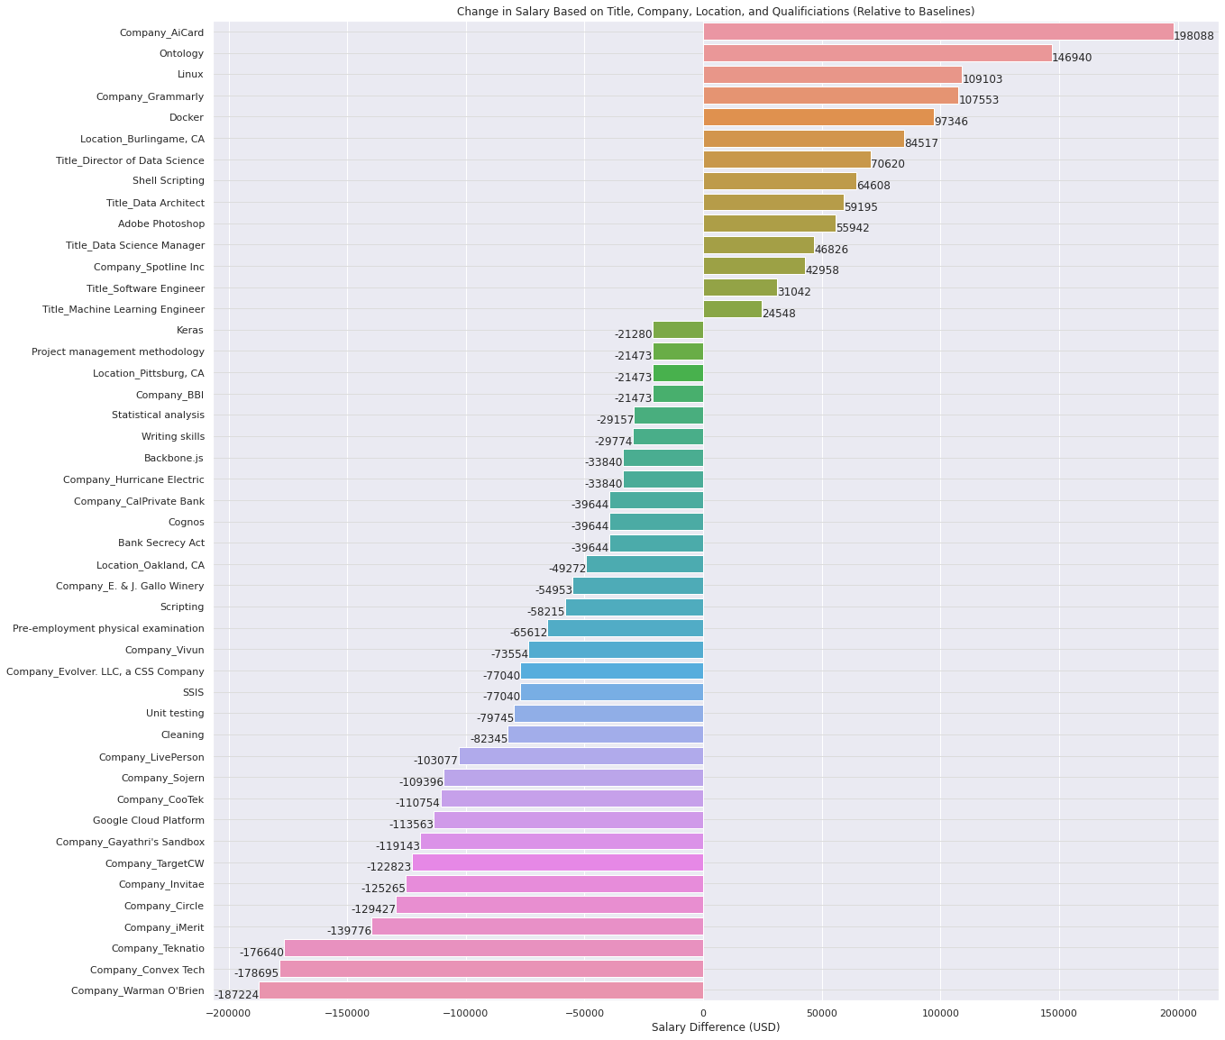
Cont.,
Visual Representation:
This slide features bar plot highlighting the effect size of significant predictors and p-values indicating the statistical significance of each predictor.

Slide 21
06
Findings
Key Highlights and Insights:
From KDE Plots and Histograms:
Salary Distribution by Title and Level: The Kernel Density Estimation plots revealed clear differences in salary distributions among job titles and levels. Senior positions consistently show higher salary ranges, emphasizing the premium on experience and expertise in the field.
Common Salary Ranges: Histograms helped identify the most frequent salary ranges, indicating that the majority of data science roles offer salaries between $70,000 and $120,000The distribution also showed right-skewness, pointing to a significant number of high-paying jobs that pull the average salary upwards.

Slide 22
Cont.,
2. From Bar Charts:
Prevalence of Job Levels: Bar charts demonstrated that entry-level positions are more common than senior roles, suggesting a funnel effect in career progression within the data science industry.
Variations by Company and Location: Companies known for their tech focus and locations with high cost of living showed a higher frequency of top-tier salary offerings.
3. From Box Plots:
Variability Across Titles: Box plots displayed a wide interquartile range for senior roles like 'Senior Data Scientist', indicating variability in how these roles are valued across different companies.
Outliers: There were notable outliers in the salary data, particularly in high-tech hubs, suggesting that top talents or niche skills can command significantly higher wages.

Slide 23
Cont.,
4. From Regression Analysis Results:
Statistically Significant Predictors: The regression analysis highlighted that job title, location, and company significantly affect salaries, with advanced qualifications also playing a key role, albeit to a lesser extent.
Quantitative Impact: For instance, moving from a mid-level to a senior data scientist role can increase salaries by approximately 20%, demonstrating the value of career advancement.
Concluding Thoughts:
These findings underscore the importance of strategic career planning in data science. Understanding the factors that influence salary can help professionals make informed decisions about job transitions, skill development, and negotiation strategies.

Slide 24
07
Conclusion
=> These findings underscore the importance of strategic career planning in data science. Understanding the factors that influence salary can help professionals make informed decisions about job transitions, skill development, and negotiation strategies.

Slide 25
Recommendations
For Professionals:
Skill Enhancement: Continuously update and enhance skills, especially in emerging technologies and data science methodologies.
Career Planning: Strategically plan career moves focusing on roles and locations that offer higher salaries and better career progression opportunities.
Negotiation: Leverage insights about high-paying roles and companies during salary negotiations.
For Employers:
Competitive Salaries: Offer competitive salaries to attract top talent, particularly in high-demand areas and for senior positions.
Employee Development: Invest in training and development programs to enhance employee skills, which can increase productivity and retention.
Benefits and Perks: Consider expanding the range of benefits and perks, as these are significant factors in job satisfaction and employee retention.

Slide 26
THANK YOU

